Slide 1

Data Mining/Recommender System
Personalized Tourism Itinerary Recommender System
Guide: Dr. B Narsing Rao
Team:
Chiranth Gopal K 1PI13CS047
Gourish Hebbar 1PI13CS062
Dept of CSE Jan - May 2017

Slide 2
Data Mining/Recommender System
Problem Statement
To provide personalized itinerary for attractions based on user location and preferences
Dept of CSE Jan - May 2017

Slide 3
Data Mining/Recommender System
Solution
To build a web app using a recommendation engine which generates a path of places to be visited in particular order
Dept of CSE Jan - May 2017

Slide 4
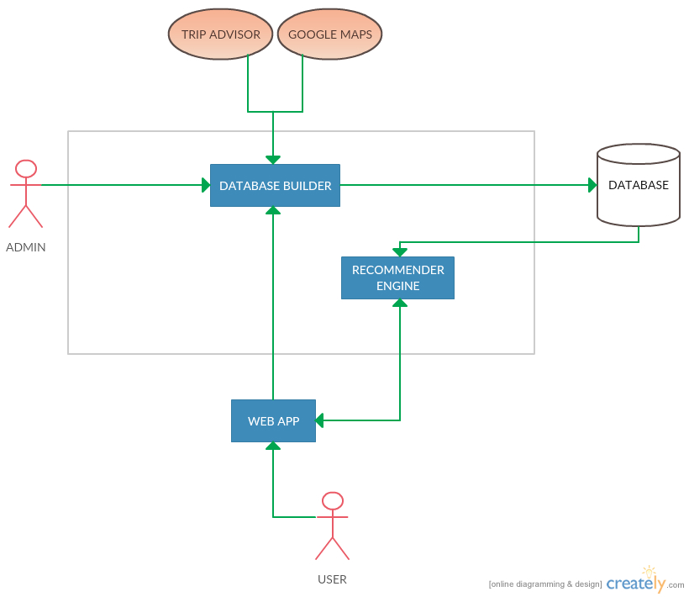
Data Mining/Recommender System
High Level Architecture
Dept of CSE Jan - May 2017

Slide 5
Data Mining/Recommender System
Brief Overview
Show user recommended places with ratings and suggested time to be spent on the place on a map
Also show other recommendations as a list of places
User can
Modify the time they would want to spend at a place
Add/remove a place from itinerary generation using the recommended places list
For stay of multiple days, places visited on the previous days will be excluded from further recommendations
Dept of CSE Jan - May 2017

Slide 6
Data Mining/Recommender System
Modules
Data scraping
Front end HTML
Front end JavaScript
Back end PHP
Dept of CSE Jan - May 2017

Slide 7
Data Mining/Recommender System
User inputs
Duration of stay
Start time for the day
End time for the day
Start/end point of the trip
Preferences of place
Dept of CSE Jan - May 2017

Slide 8
Data Mining/Recommender System
Scraping
We have scraped data for places around Mysore and have stored it in MySQL
Columns of the scraped data are
Place name
Categories
Latitude
Longitude
URL for more details
Average time spent per visit (Manual input)
Dept of CSE Jan - May 2017

Slide 9
Data Mining/Recommender System
Caching distance and time data
We have also stored data for the distance and time taken to travel from one place to another
This data is required for generating distance matrix
Columns of the cached data are
Source Place ID
Destination Place ID
Distance
Time
Dept of CSE Jan - May 2017

Slide 10
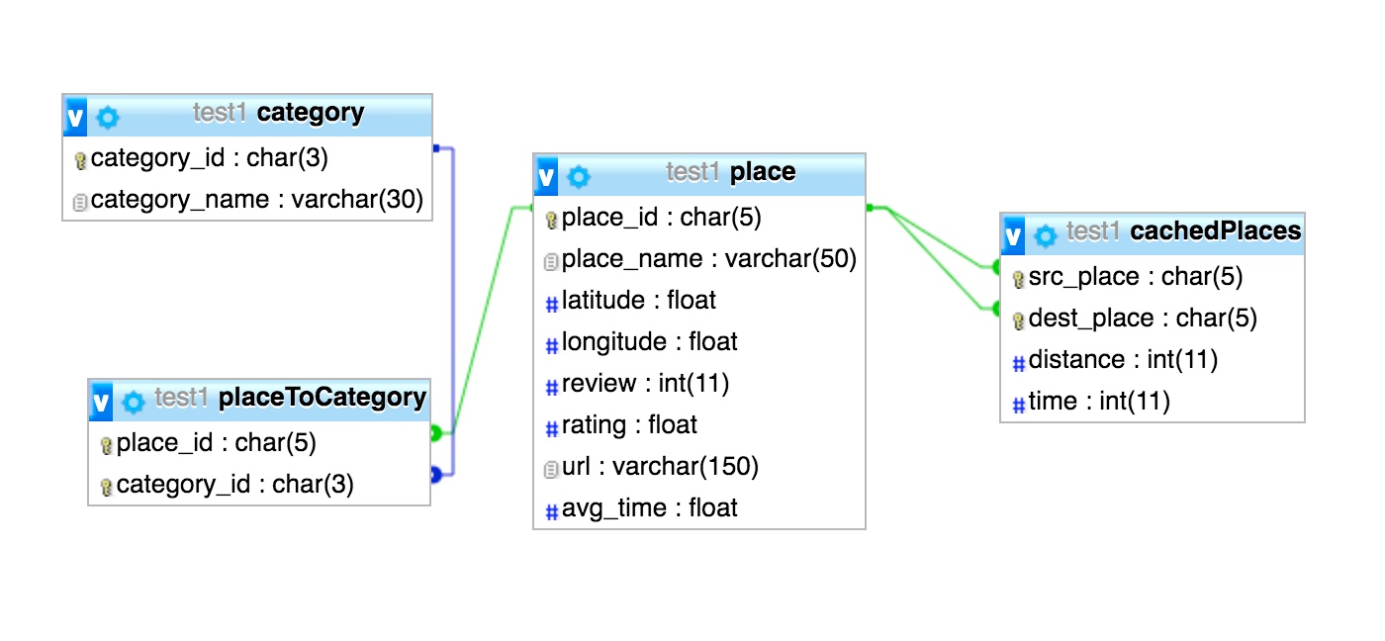
Data Mining/Recommender System
Database Schema
Dept of CSE Jan - May 2017

Slide 11
Data Mining/Recommender System
Front end
User can select categories of places, can choose multiple of them, and as and when he selects, the relevant results of places are shown.
He can choose start/end location on the map by dropping a marker.
He can enter the date and time of the duration of visit in the second tab
Results shown to the user contain the place name, along with the other details, sorted in the order of normalised ratings.
TheTripAdvisor link of the place is included in the name of the place.
Dept of CSE Jan - May 2017

Slide 12
Front end continued
Data Mining/Recommender System
Clicking anywhere else on the result of each place, will highlight the place on the map.
We give the user the recommended time to spend at the place, and also give a slider to edit the time to whatever duration the he would like to spend there.
Checkboxes are included so that the user can select which places he wants to visit and then we generate the places on the map, in the order of visit suitable, to maximise the profit.
Places list is available in every tab for easier access and reference
Auto generate option available for quick recommendation

Slide 13
Back end
Data Mining/Recommender System
Based on the categories the user selects, an AJAX call goes to the backend.
We have a PHP backend file, which takes this request, opens a connection to the database, and fetches the data through a query and returns it
We display the places belonging to relevant categories
Then, when user chooses the places or selects auto generate, the list of places selected will go as data through another AJAX call
This will fetch the distance matrix among all the places selected and the user’s location

Slide 14
Data Mining/Recommender System
Computations
We take this data and find the cost between edges
We minimise the cost of edge between places and apply the travelling salesman problem.
Formula to calculate edge of cost:
Cost = a * duration of visit - b * rating + c * avg. time at place
The algorithm will use the distance matrix, and depending on the cost of the edge, will choose to go to that place in the itinerary
Dept of CSE Jan - May 2017

Slide 15
Data Mining/Recommender System
Computations continued
When user selects multiple days trip, need to divide the places selected to be visited on all the available days
So our approach is to use K means clustering
We take the places selected, apply K-Means on the latitude and longitude values of the places and determine the clusters
Then we assign one cluster for each day, and generate the itinerary
Dept of CSE Jan - May 2017

Slide 16
Data Mining/Recommender System
Front end continued
Once the itinerary is generated, we display it on the map as a series of places, each marked in successive letters
Along with the map, we show a table of the itinerary in the third tab
The details in the table are place, arrival, average time spend and departure times
User can only see the itinerary one day at a time. He can choose the day in the dropdown and the itinerary for corresponding day is displayed
Dept of CSE Jan - May 2017

Slide 17
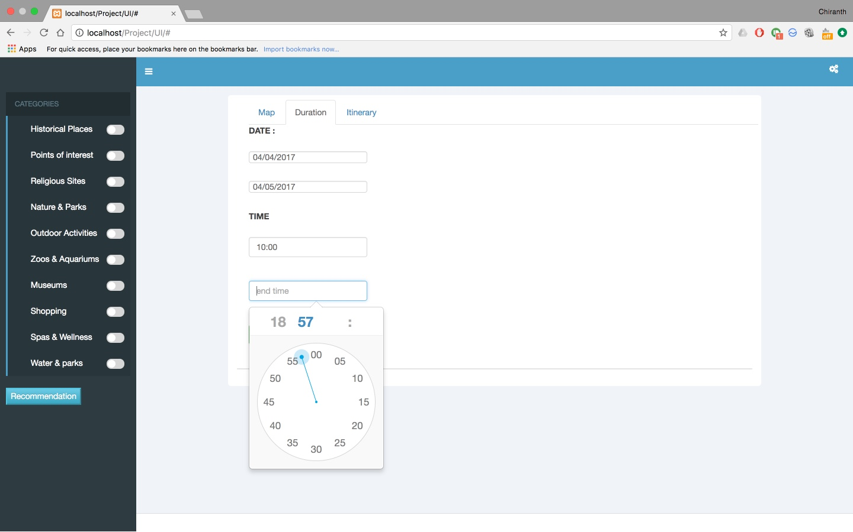
Data Mining/Recommender System
Screenshots
Setting date and times
Dept of CSE Jan - May 2017

Slide 18
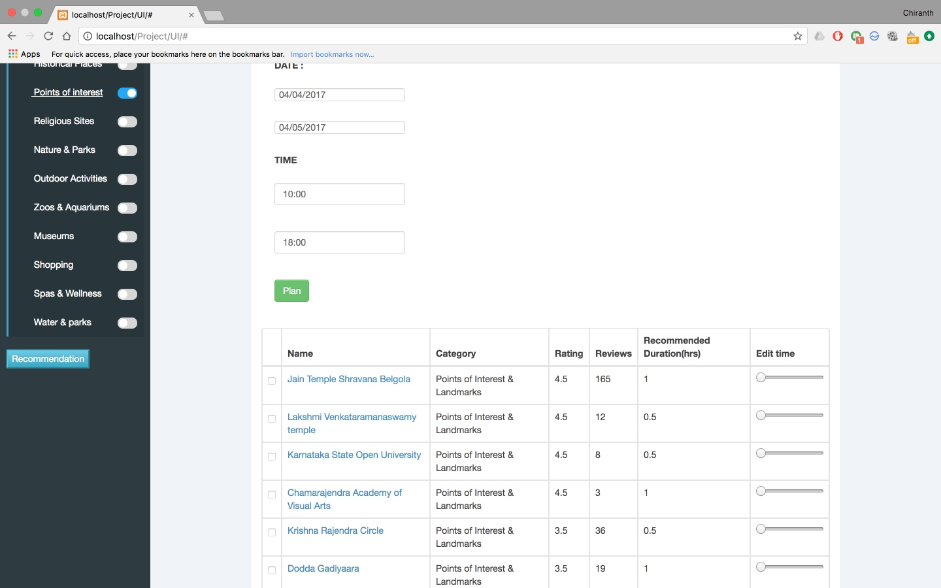
Data Mining/Recommender System
Screenshots
Selecting category
Dept of CSE Jan - May 2017

Slide 19
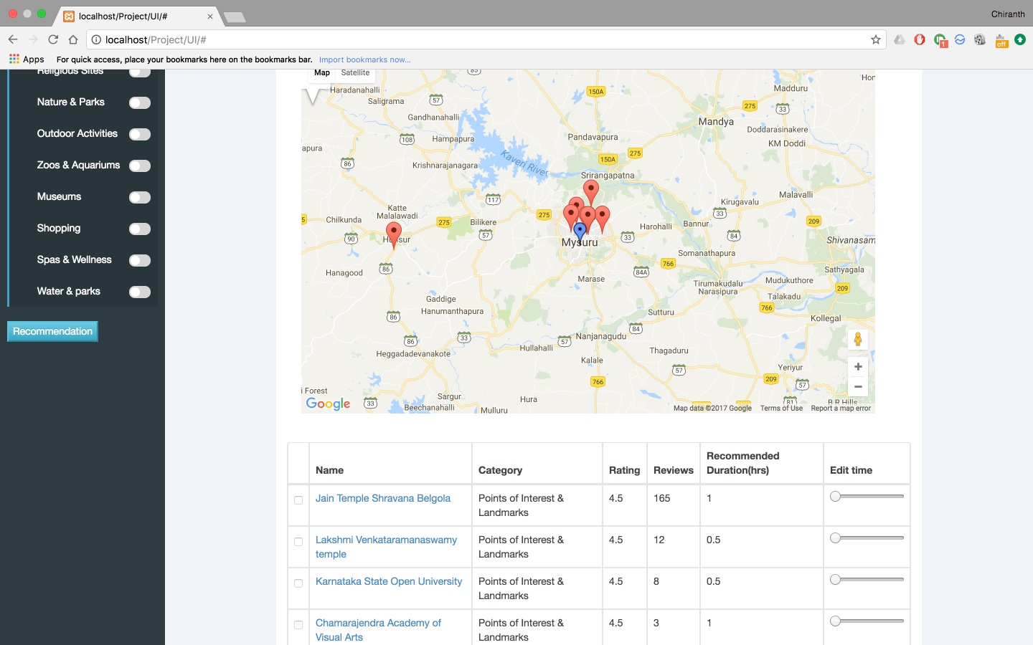
Data Mining/Recommender System
Screenshots
Showing places on the map
Dept of CSE Jan - May 2017

Slide 20
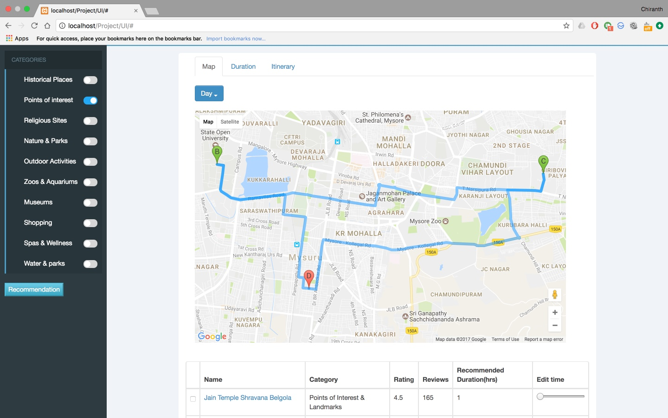
Data Mining/Recommender System
Screenshots
Itinerary on the map
Dept of CSE Jan - May 2017

Slide 21
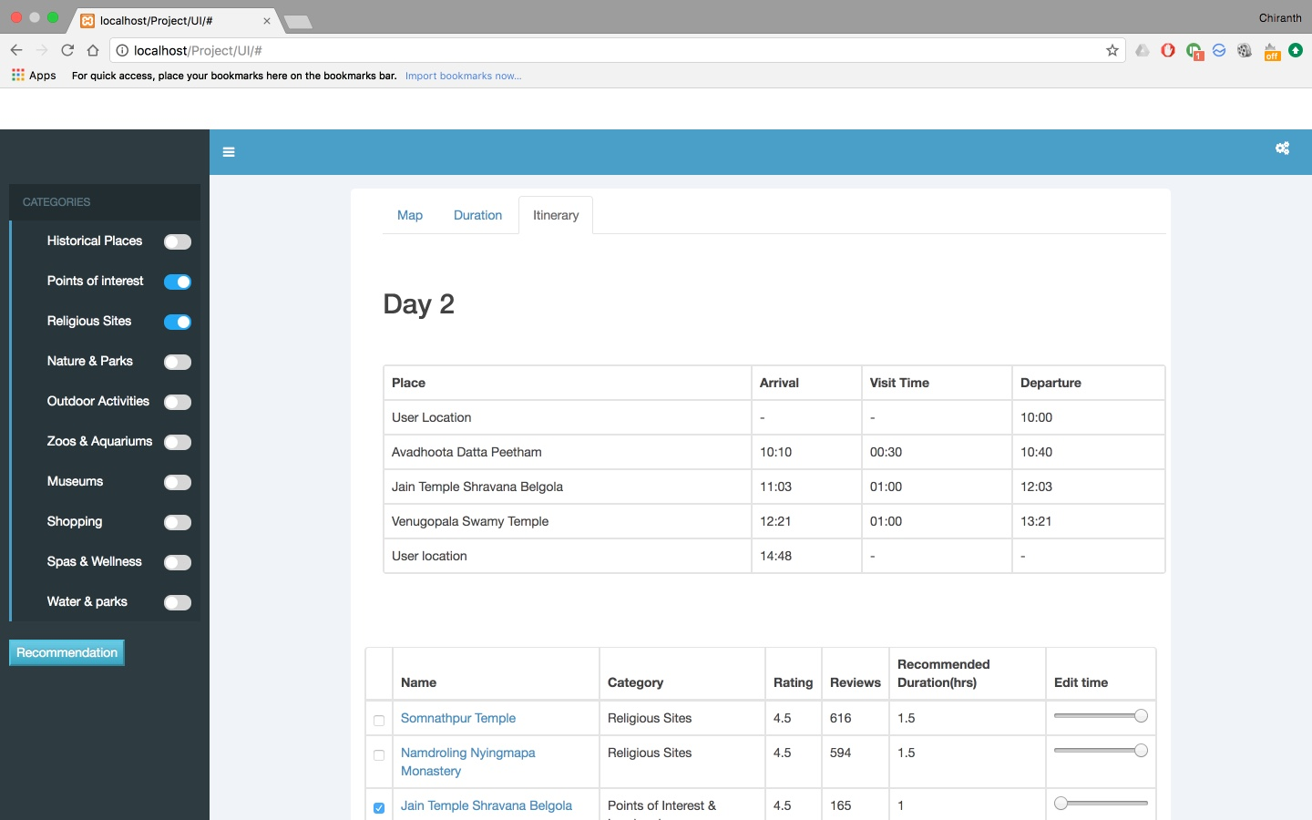
Data Mining/Recommender System
Screenshots
Itinerary table
Dept of CSE Jan - May 2017

Slide 22
Data Mining/Machine Learning
Thank you
Dept of CSE Jan - May 2017

